Slide 1
Introduction Attendance in SIMS Trainer: Sheryl Everett webinar will start at 10.00am

Slide 2
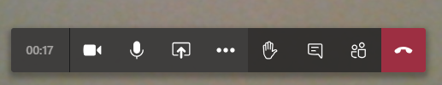



Housekeeping
Please turn off all cameras
Mute microphones
We welcome contributions throughout.
Please use the chat / message facility on Teams, which will be responded to after the demonstration.

Slide 3
Agenda
Introduction
DfE Guidance and Attendance codes
Taking Register
Edit Attendance
Attendance Reporting

Slide 4
Introduction
Where to find information:
Department of Education Attendance guidance:
https://assets.publishing.service.gov.uk/government/uploads/system/uploads/attachment_data/file/1039223/School_attendance_guidance_for_2021_to_2022_academic_year.pdf
https://www.gov.uk/government/publications/school-attendance/addendum-recording-attendance-in-relation-to-coronavirus-covid-19-during-the-2021-to-2022-academic-year
County Attendance Team - SchoolsWeb
https://schoolsweb.buckscc.gov.uk/behaviour-wellbeing/county-attendance-team/

Slide 5
Introduction
Decisions to be made:
Who enters the data?
Method of data entry for the initial mark
Frequency of data entry
Method of data entry for absence

Slide 6
Introduction
Considerations:
Is manual entry practical (size of school)
Who is charged with monitoring absence/lateness
Who will make the ultimate decision about authorising an absence?

Slide 7
Introduction
Methods of entry
Direct entry by Registration Teachers
Block manual entry – consider duplication of time
Individual Lesson monitoring – Secondary Schools

Slide 8
Introduction
Key Principles of Good Practice
Initial accurate recording of statutory mark
Timely and accurate administration of ‘Missing’ marks and reasons for absence
Clear escalation procedure for problems arising from above
Regular monitoring and reporting
A clearly defined attendance process management structure

Slide 9
Attendance Codes
Initial mark entered at time of registration:
/ or \ Present
N* Absent
L Late
Temporary mark to be cleared at earliest opportunity
Attendance codes can be restricted for users
Regular ‘Housekeeping’ routines and active management ensures accurate and up to date information is stored.

Slide 10
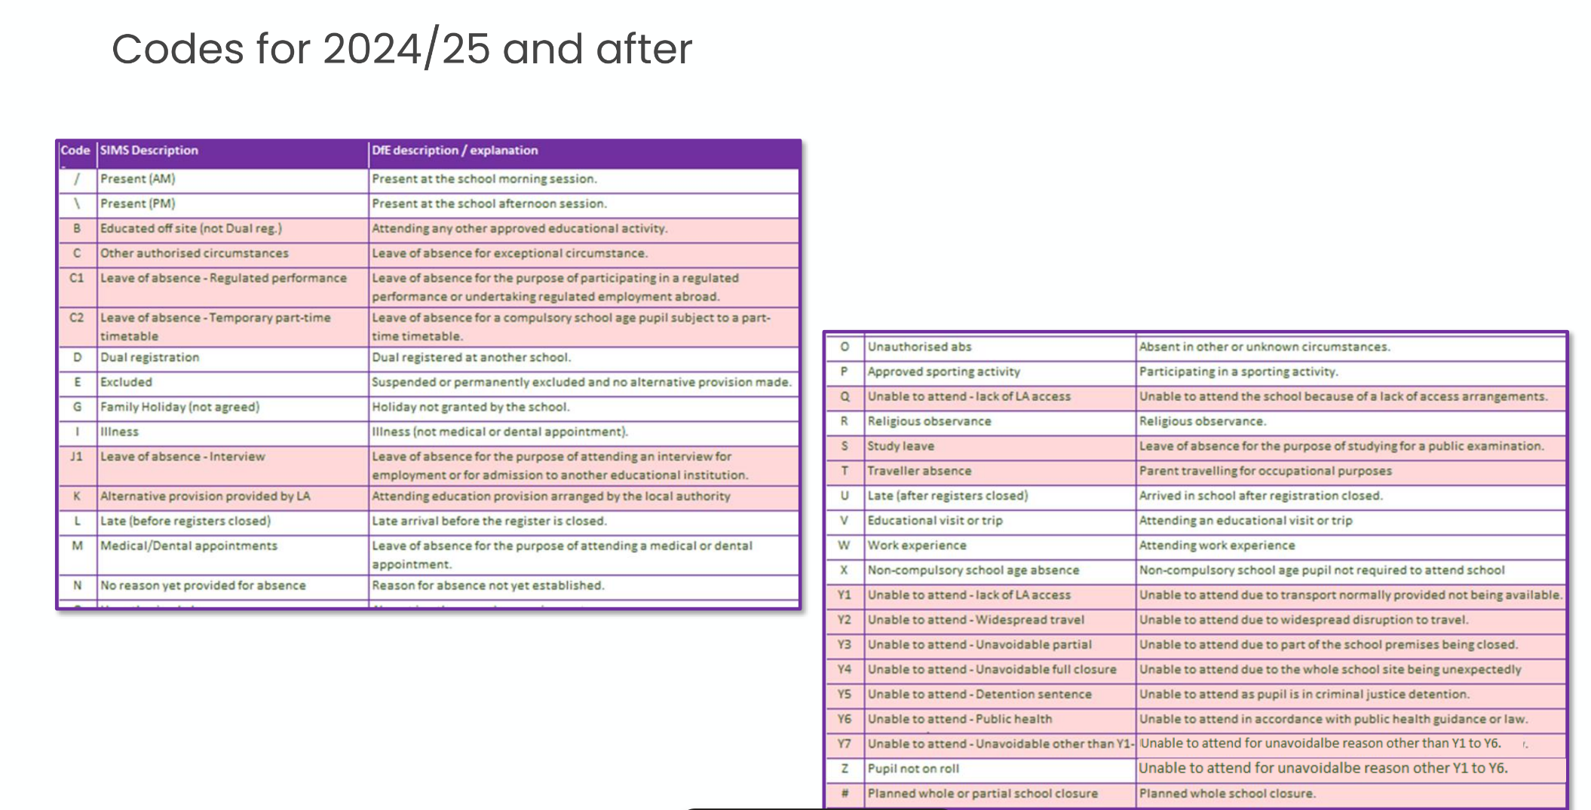
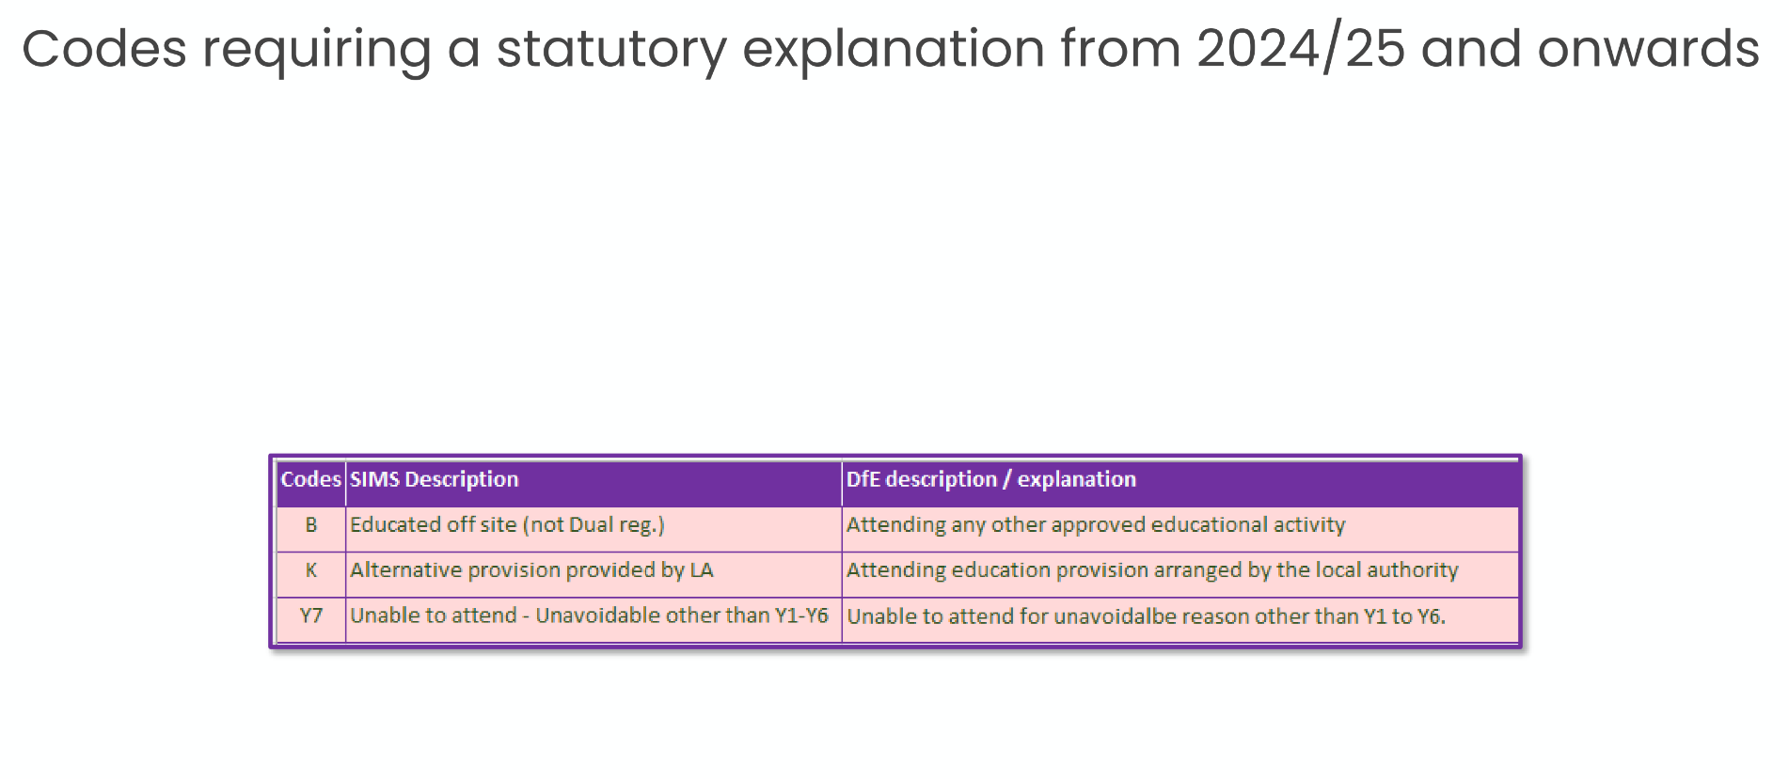

Slide 11
Attendance Codes
Code X
Normally used for Non-Statutory school aged pupils not required to be in school
Not included in Census returns and not used for attendance statistics.

Slide 12
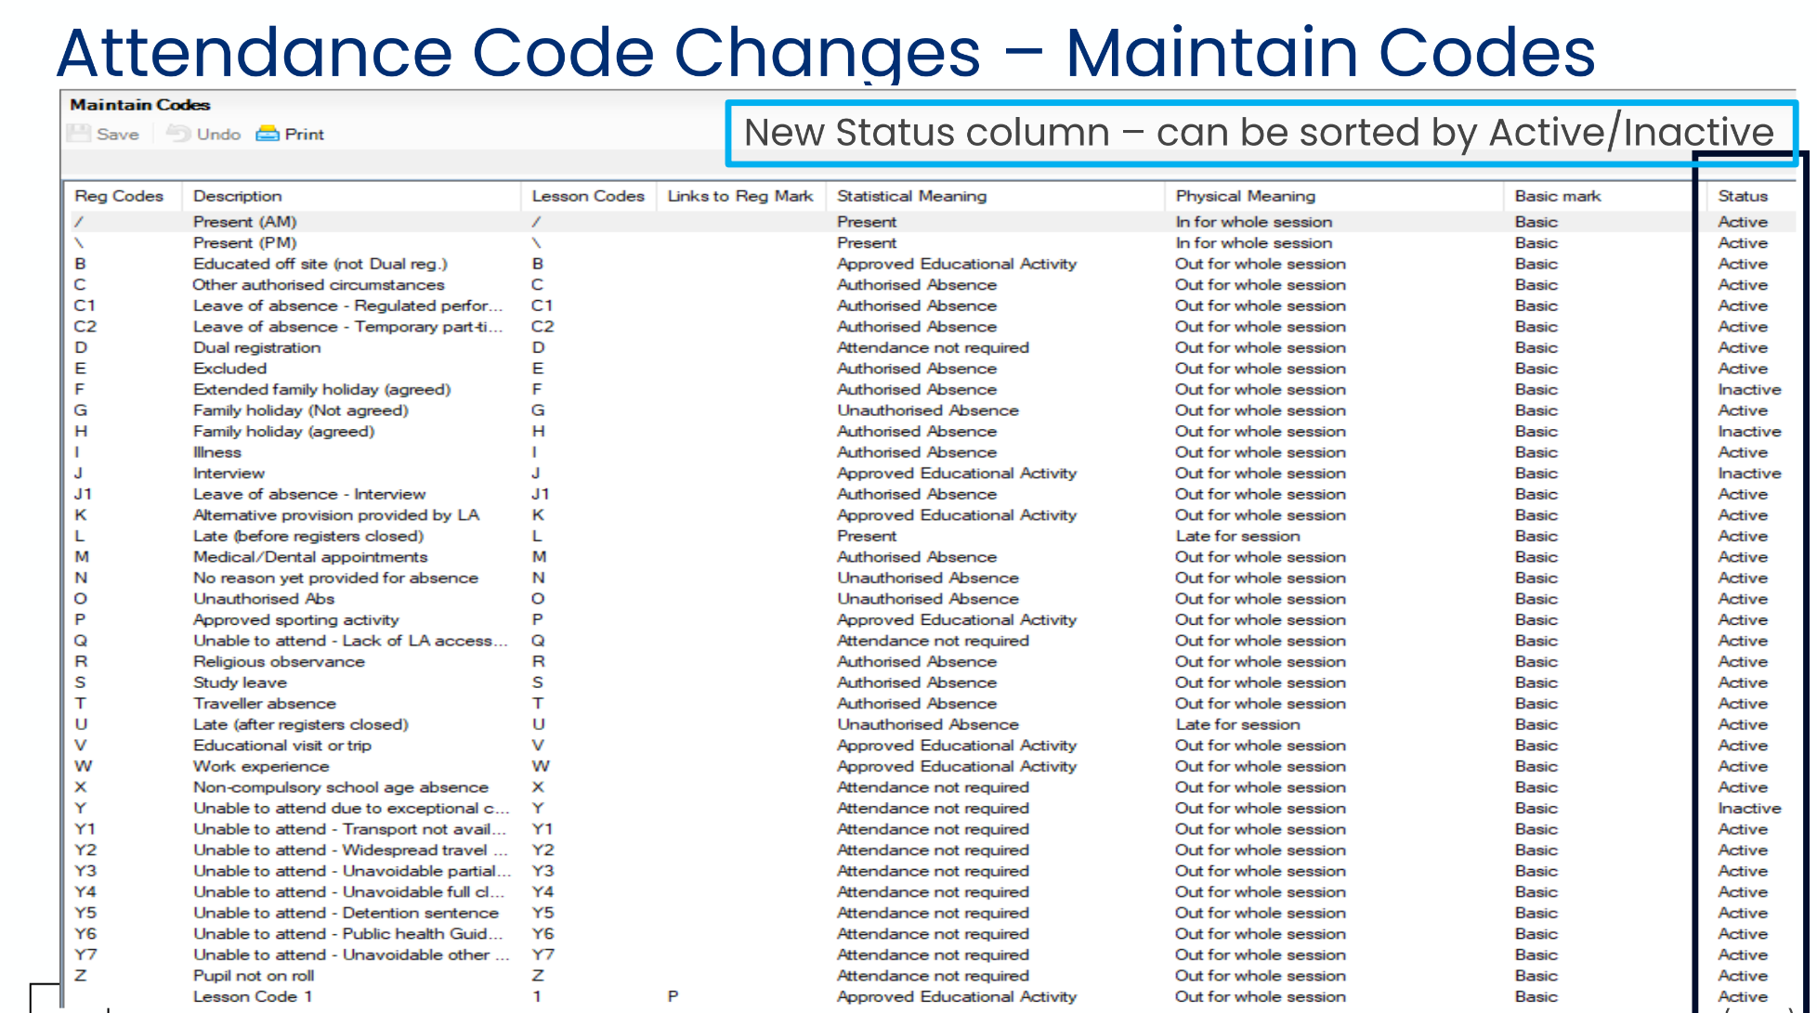

Slide 13
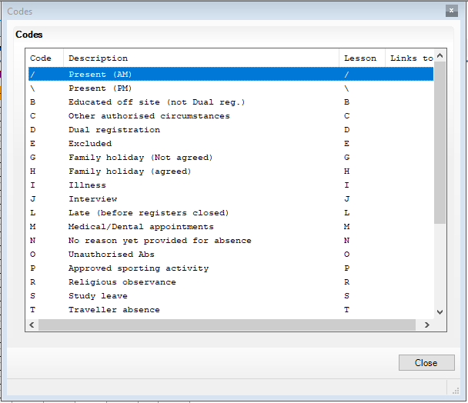
Attendance codes
Codes are available in SIMS in a pop out box.
You’re not expected to memorise them!

Slide 14
Using SIMS Attendance Module Live Demonstration

Slide 15
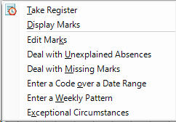
Administrative Access
Route for non-teaching staff
Edit Marks - done on an individual or group basis
Deal with Unexplained Absences
Deal with Missing Marks
Enter a Code over a Date Range
Enter a Weekly Pattern
Exceptional Circumstances

Slide 16
User Defined Groups
Ability to create groups such as attendance monitoring groups, Travel co-horts, school trips
Not just used for attendance
Reporting and editing of marks available

Slide 17
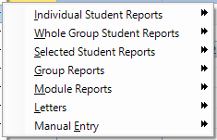
Attendance Reporting
Wide variety of built in Reports
Individual
Whole Group
Selected Students
Letters
Manual Entry Registers

Slide 18
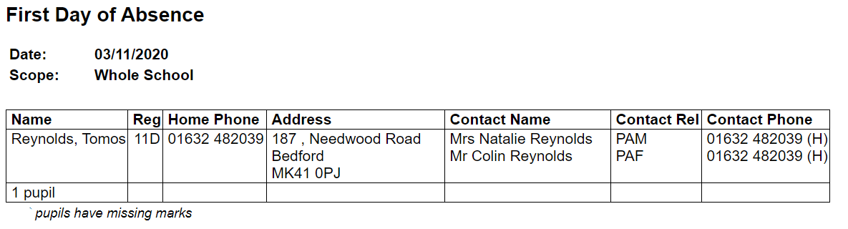
Attendance Reporting
Fire Drill
Today’s register Report: prints for whole school in Reg group order – contains marks present at the time it is run. (many schools have invested in an express printer for running this report)
First Day Absence Monitoring
Built in report to run daily:

Slide 19
Attendance Reporting
Lesson Monitoring
Not only safeguarding but how much curriculum are students missing? Can you identify a pattern in non attendance?
Letters
Automated process using attendance marks to target letters to parents of students with:
Persistent absences
Frequent holidays
Good Attendance – can create certificates automatically

Slide 20
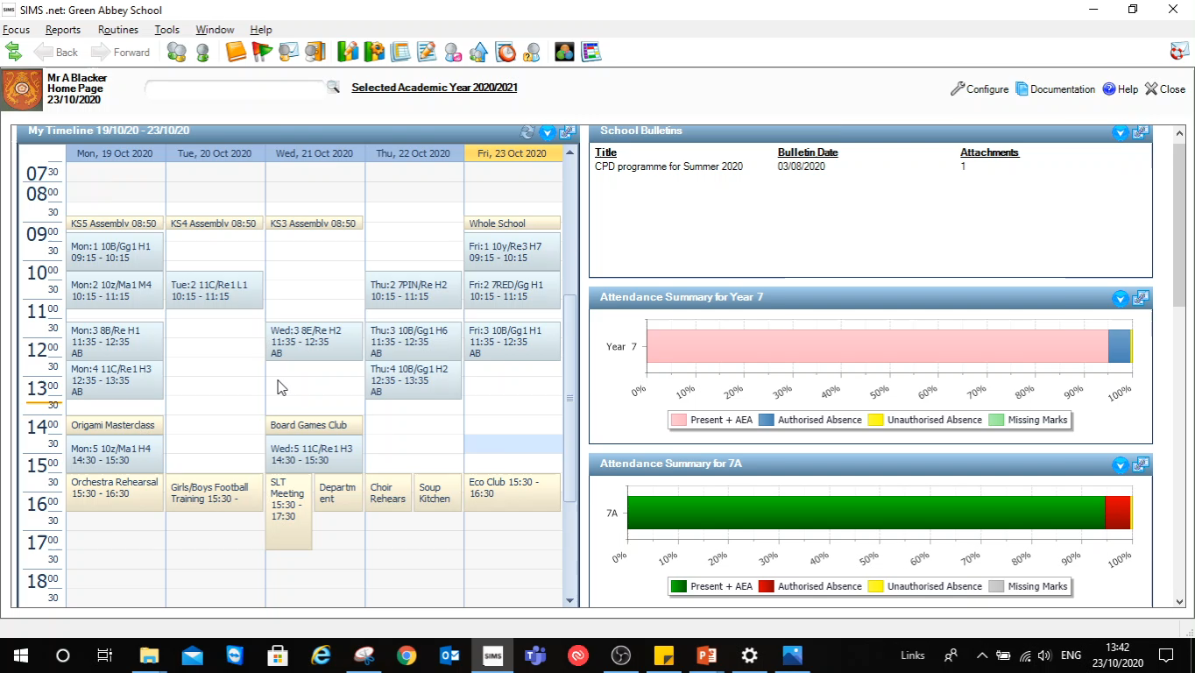
Insert demonstration

Slide 21
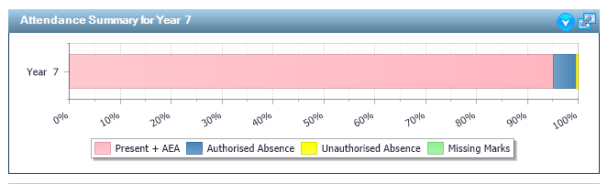
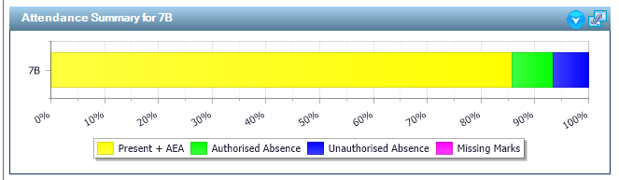
Monitoring via SIMS Home Page

Slide 22
School Report
Designed with Ofsted in mind
Contains key pastoral factors, attendance breakdown, assessment and more.
Provides them with information to start the ball rolling.
Recent upgrades allows the option to include leavers.
New upgrade allows year groups to be excluded from the report.

Slide 23



Any Questions?
Thank you for your time today.
01296 383500 Option 1
ICTSchools@Buckinghamshire.gov.uk
When logging cases look for emails from Buckscprod@service-now.com add to your safe senders list.

