Slide 1

Deactivating a User on FMS

Slide 2
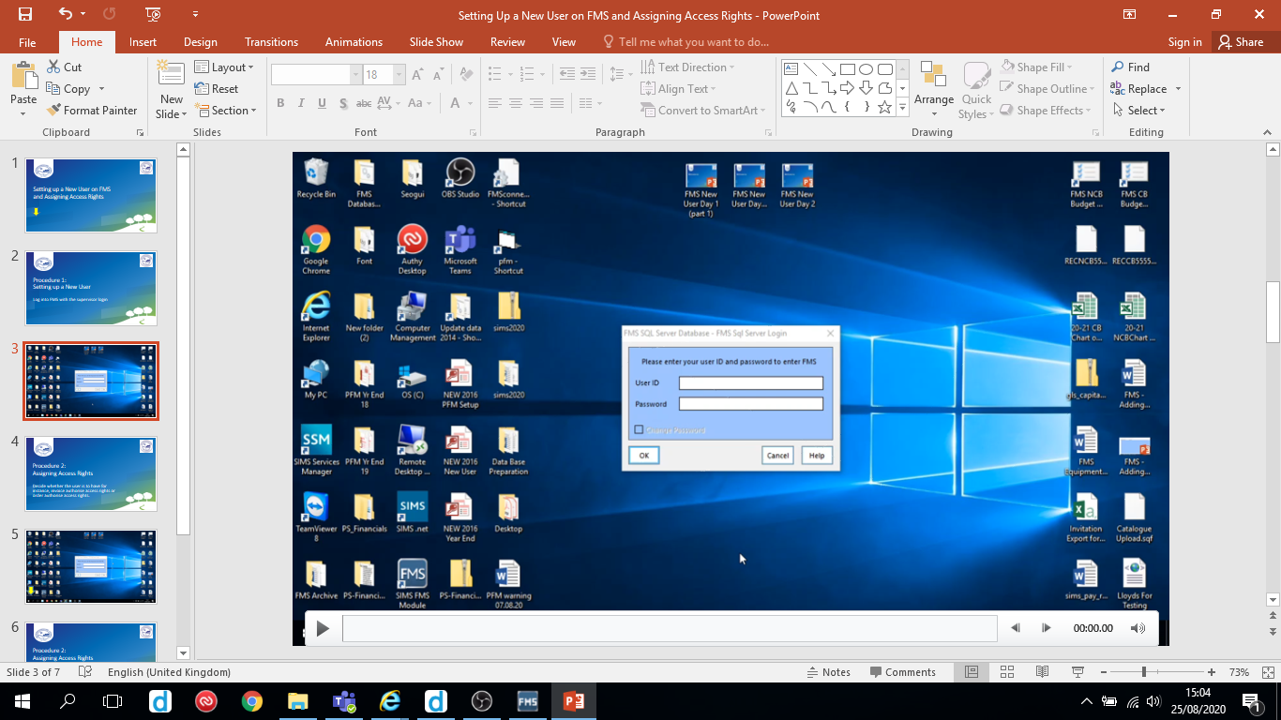
Log in as supervisor
Hover over slides to reveal the play/pause button

Slide 3
An FMS user cannot be deleted.
They can only be deactivated by giving them no access.

Slide 4
