Slide 1

Adding a Financial Subgroup to SIMS
Adding a Service Term Mapping in FMS

Slide 2
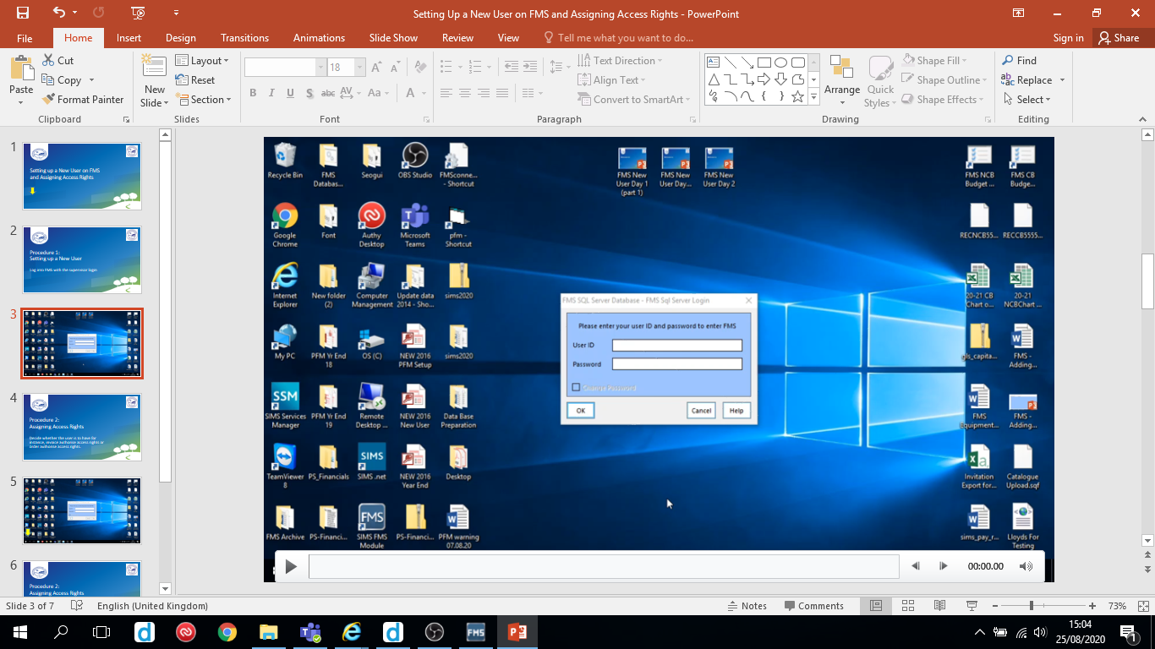
Hover over slides to reveal the play/pause button

Slide 3
Log into SIMS with the Personnel Officer access rights.
Follow the video on the next slide.

Slide 4
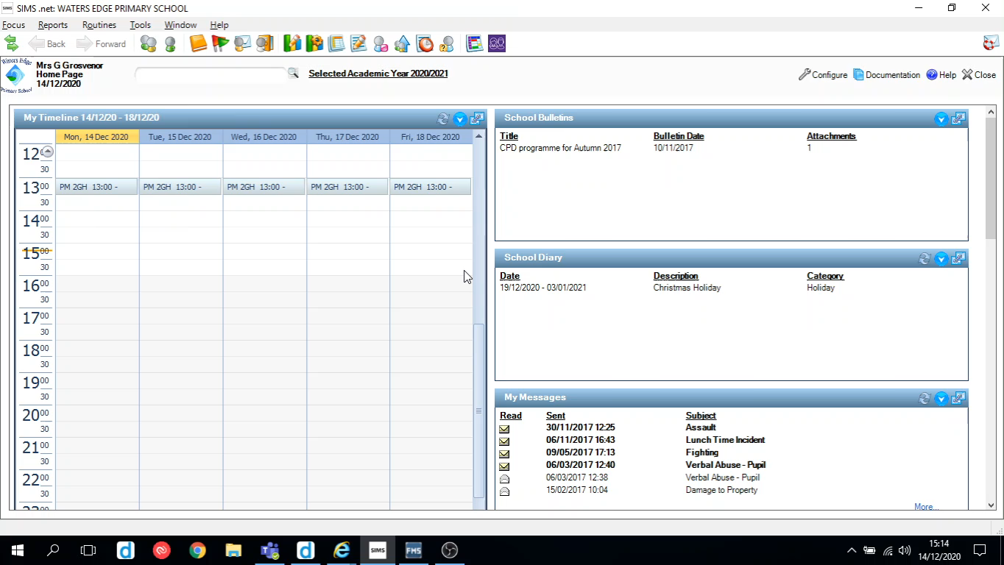

Slide 5
Follow the video in the next slide to map the Financial Subgroup in FMS.

Slide 6
