Slide 1

FMS – Chart of Accounts Review
Cost Centre Browse

Slide 2
The Chart of Accounts Review is a tool for viewing the effect of movements of money within the system.
Once a Cost Centre is selected, it is possible to drill down to view transactions.
A report can be created and saved to a number of applications including Excel.

Slide 3
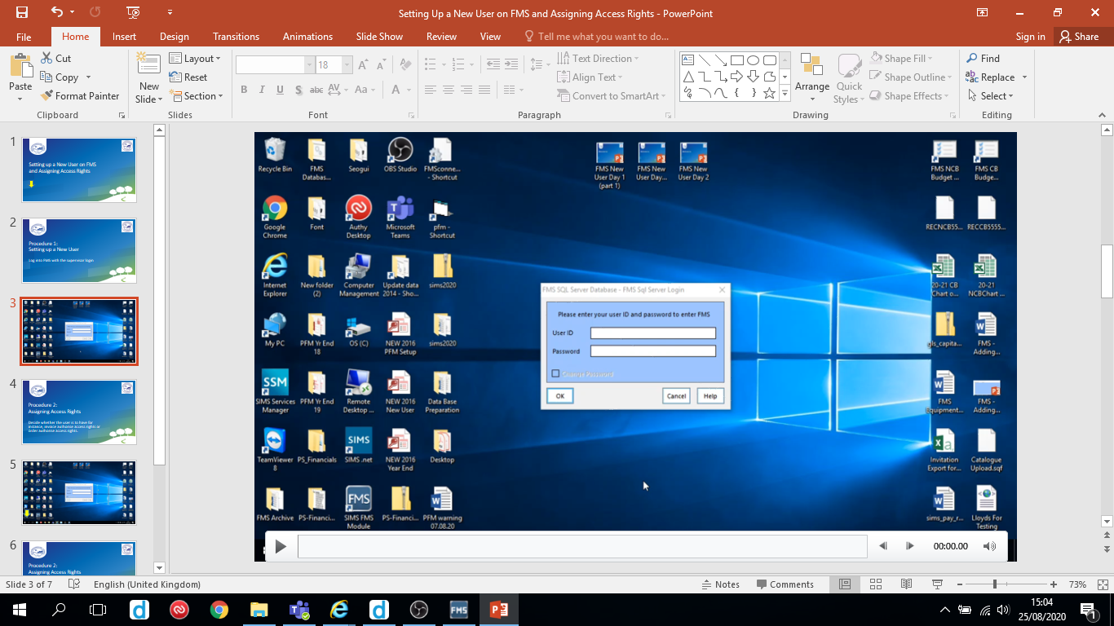
Follow the video on the next slide to investigate the Chart of Accounts Review Cost Centre browse.
Hover over the slide to reveal the play/pause button

Slide 4
