Slide 1

FMS – Chart of Accounts Review
Reconciling Ledger Code Balances

Slide 2
Financial Regulations require schools to reconcile their FMS Ledger Code balances with those on the SAP Transactions Report issued by SAST on a monthly basis.

Slide 3
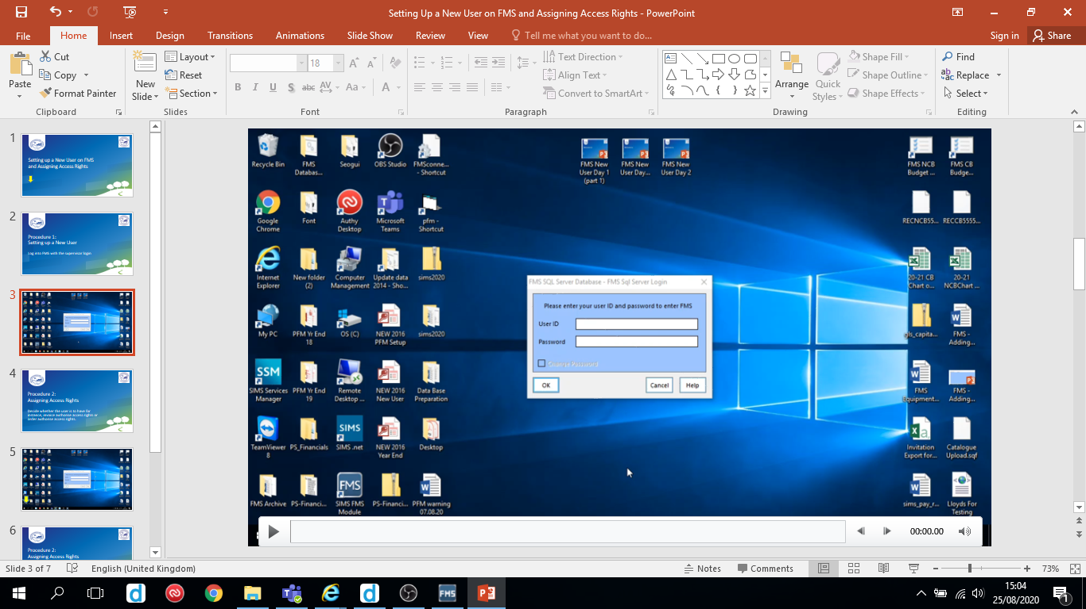
Follow the video on the next slide to see where to find the FMS Ledger Code balances in the Actual column of the Chart of Accounts Review area.
Hover over the slide to reveal the play/pause button

Slide 4
