Slide 1

FMS – The Chart of Accounts Listing

Slide 2
The Chart of Accounts Listing is a report which shows all Cost Centres on your FMS system and all Ledger Codes linked to each one.
It can be saved to a number of applications including Excel.

Slide 3
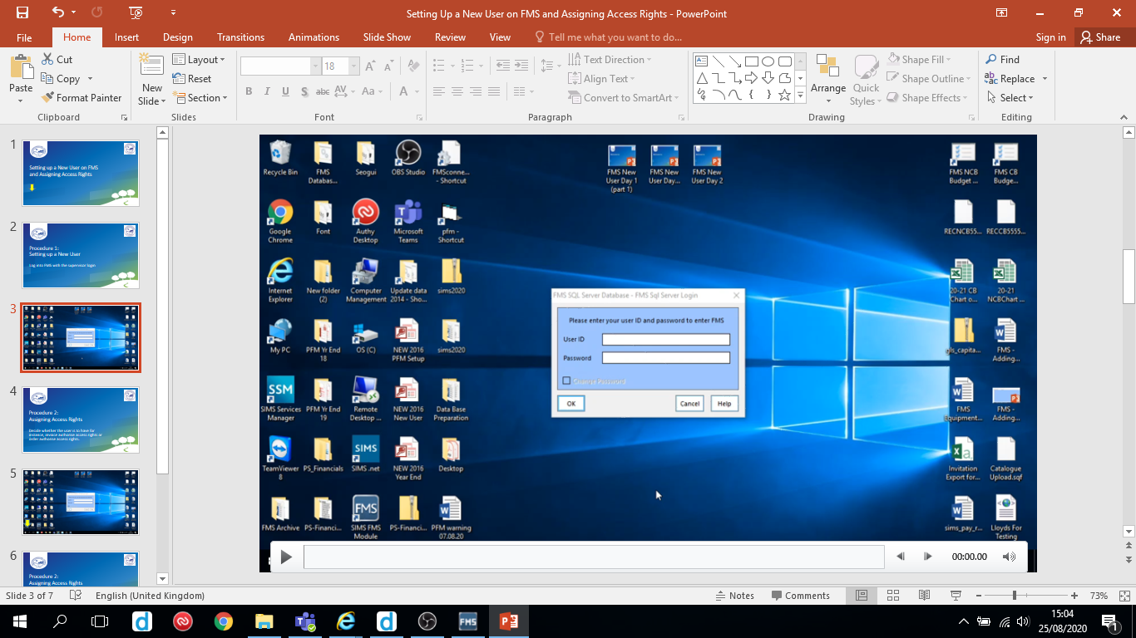
Follow the video on the next slide to create the Chart of Accounts Listing.
Hover over the slide to reveal the play/pause button

Slide 4
