Slide 1

FMS – Changes to Ledger Codes in Financial Year 2021-22

Slide 2
Ledger Codes 992359 Teachers Pension Grant and 992349 Teachers Pay Grant are no longer to be used.
It is not possible to delete Ledger Codes from FMS.
Instead they are to be taken out of use. First they should be unlinked from the Cost Centre I01 and then DNU should be added to the beginning of the Ledger Code description.

Slide 3
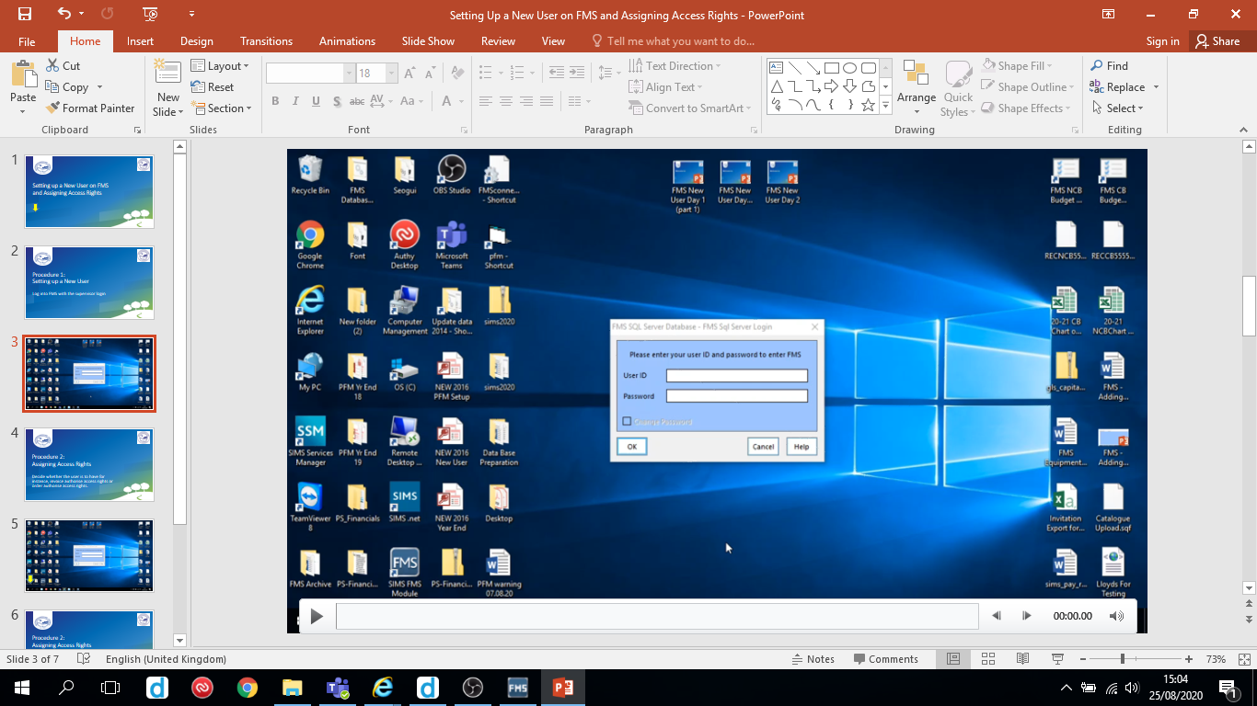
Follow the video on the next slide to take these Ledger Codes out of use.
Hover over the slide to reveal the play/pause button

Slide 4
