Slide 1

FMS – Adding a New Cheque Book
(Cheque Book Schools only)

Slide 2
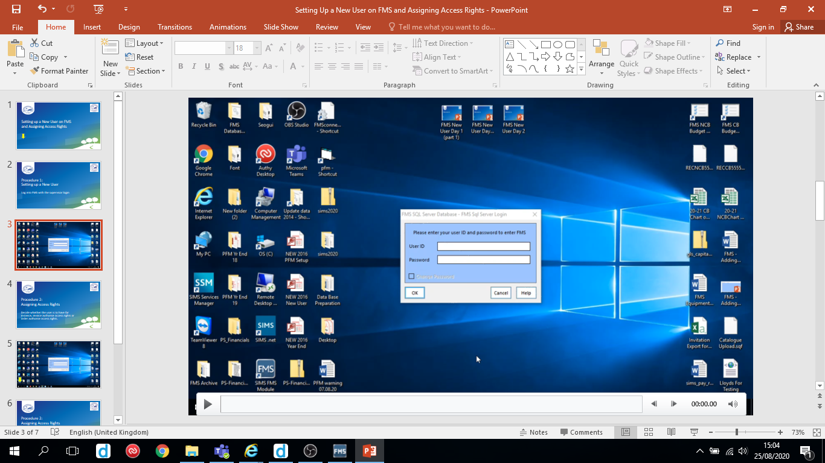
Follow the video on the next slide to add a new cheque book.
Hover over the slide to reveal the play/pause button

Slide 3
