Slide 1

FMS – Adding a New Order Book

Slide 2
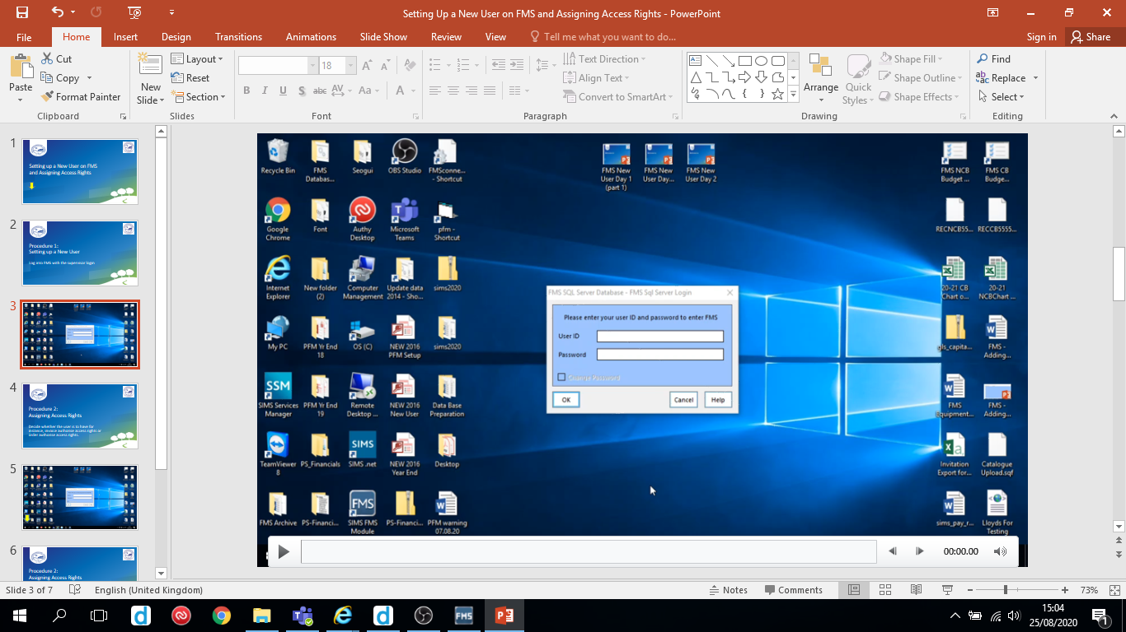
Follow the video on the next slide to add a new order book.
Hover over the slide to reveal the play/pause button

Slide 3
Non-cheque book schools select payment source Central. Cheque book schools select payment source Bank Account.

Slide 4
