Slide 1

FMS – Adding a New Petty Cash Book

Slide 2
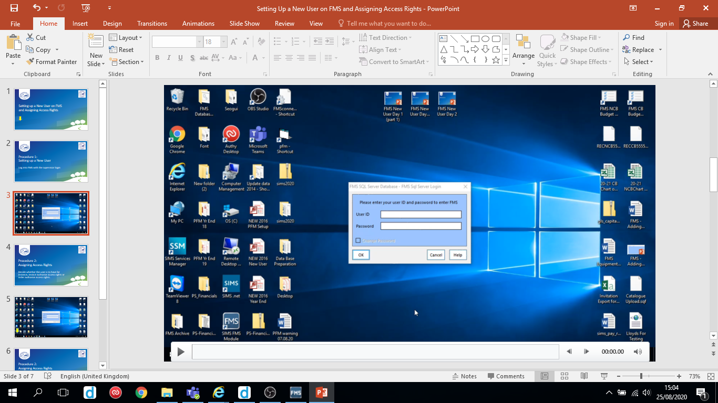
Follow the video on the next slide to add a new petty cash folio book.
Hover over the slide to reveal the play/pause button

Slide 3
